Slide 1
Transformers Architecture
Prof. Sebastián Vallejo Vera

Slide 2
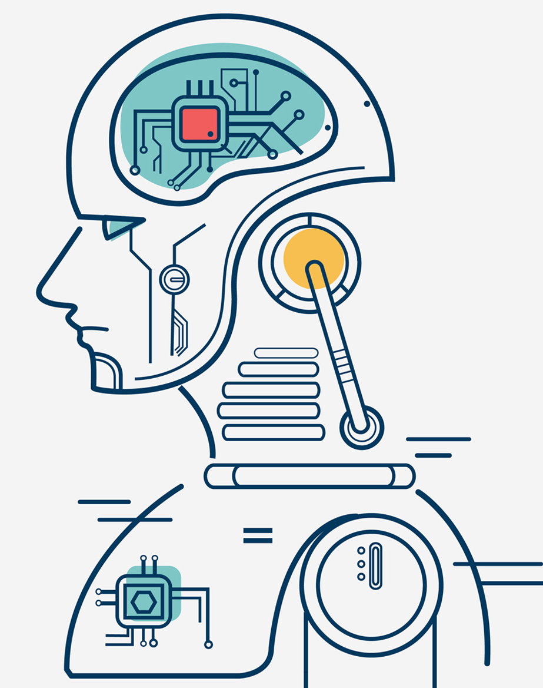
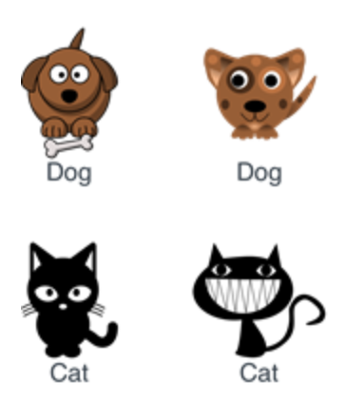
Labeled Data
Black Magic
Machine Learning Models
Prediction
It’s a dog!
or
It’s a cat!

Slide 3
Transformers

Slide 4
Wait… What are Transformers?
(And why should I care about them)

Slide 5
Transformers are a machine-learning architecture used in language-based models.
We can think of Transformers as the engines that drive machine-learning models and improve (significantly) their performance.
Transformers are the architecture behind BERT, RoBERTa, DeBERTa, etc.

Slide 6
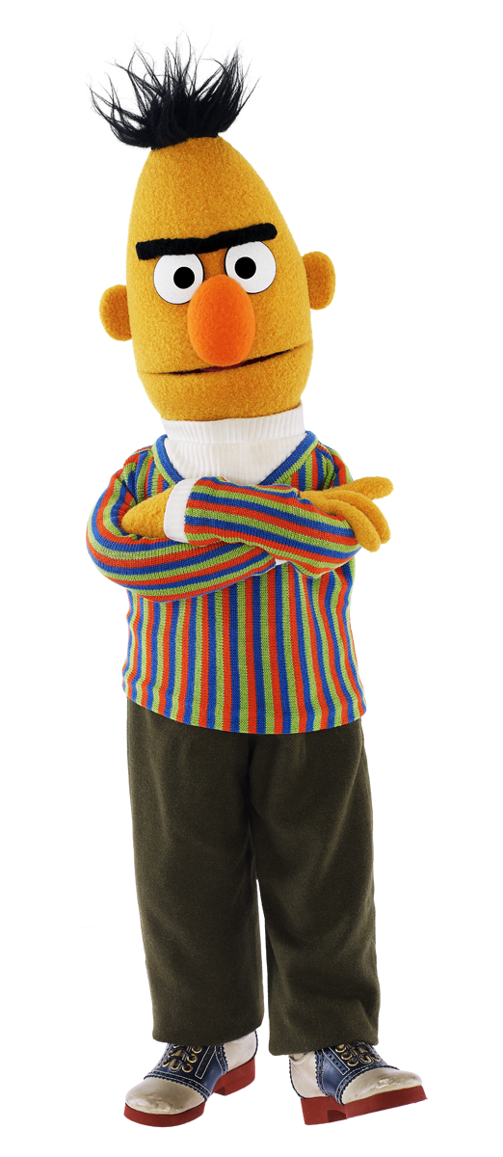
??
??

Slide 7
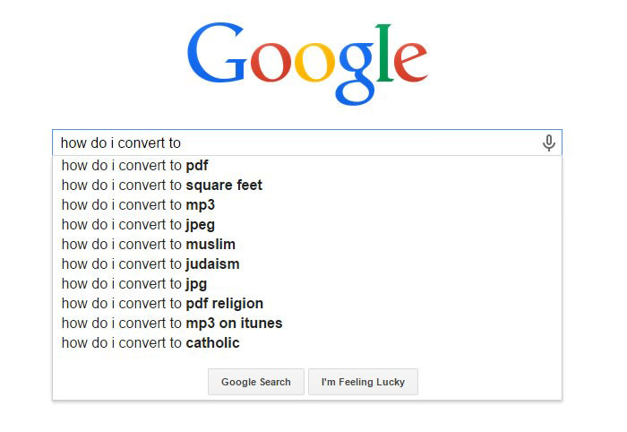
Have you ever wondered how Google can predict what you want to search?
Or why it suddenly became so good at translating? Or why ChatGPT?

Slide 8
That’s right… TRANSFORMERS!!
* GPT = Generative Pre-trained Transformer

Slide 9
Pretty cool… how do they work?
(Also… what’s up with the acronyms?)

Slide 10
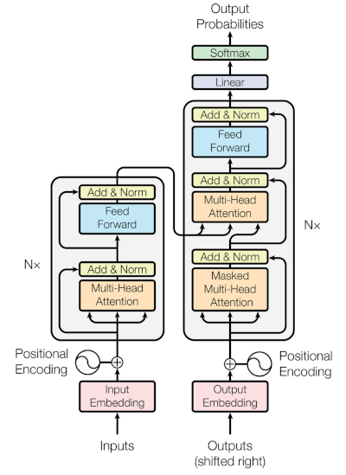
Well, it is complicated…
Encode – Decode!

Slide 11
But we can break down into different parts. We start with the encoder layer, or how Transformers create representations (i.e., embeddings) from words.

Slide 12
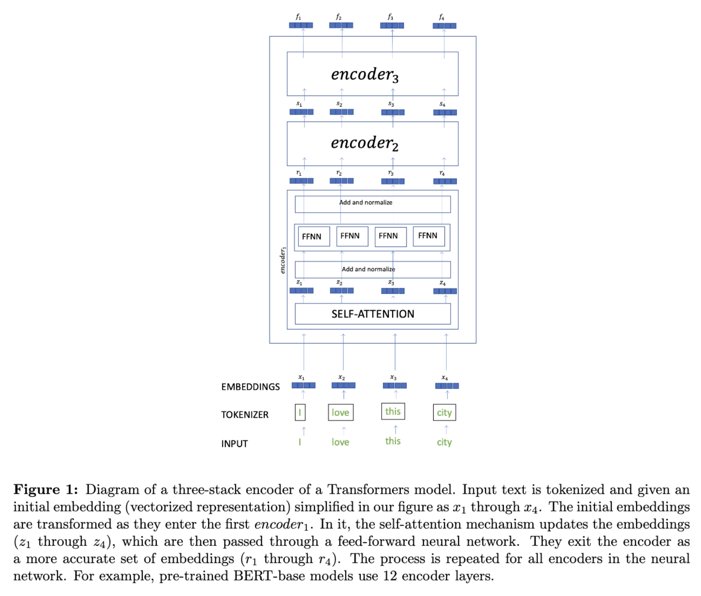

Slide 13

Attention is all you need

Slide 14
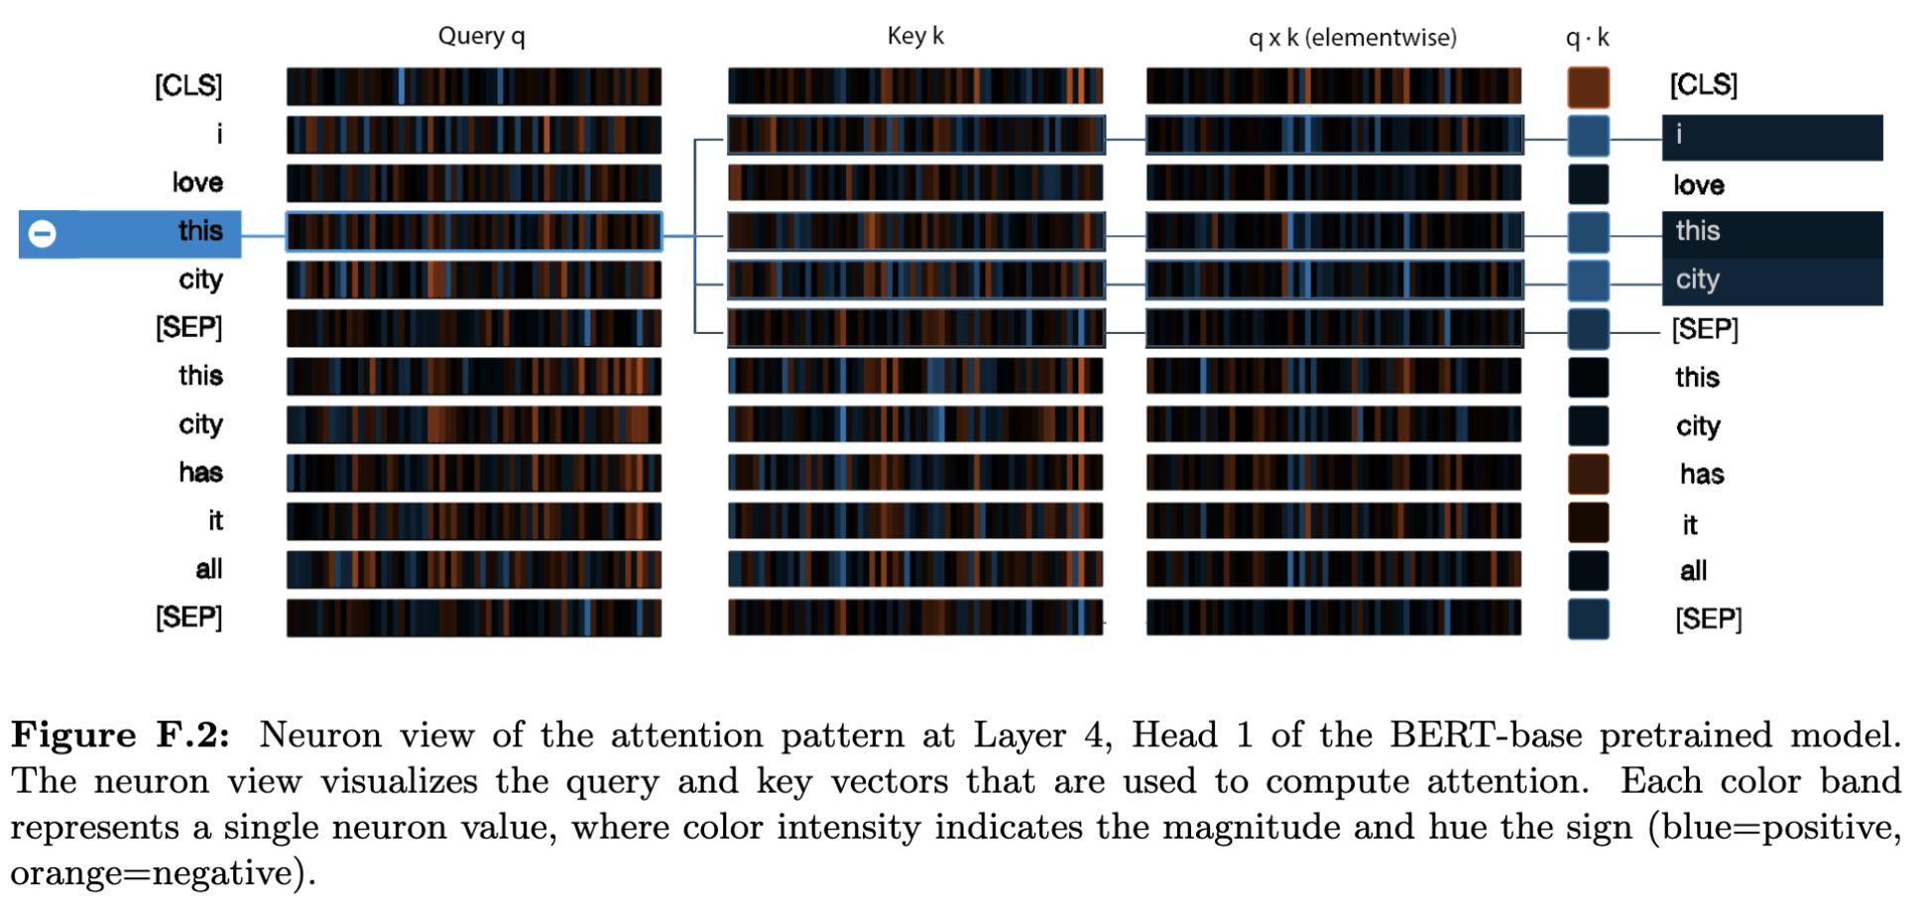

Slide 15

Mask it!

Slide 16
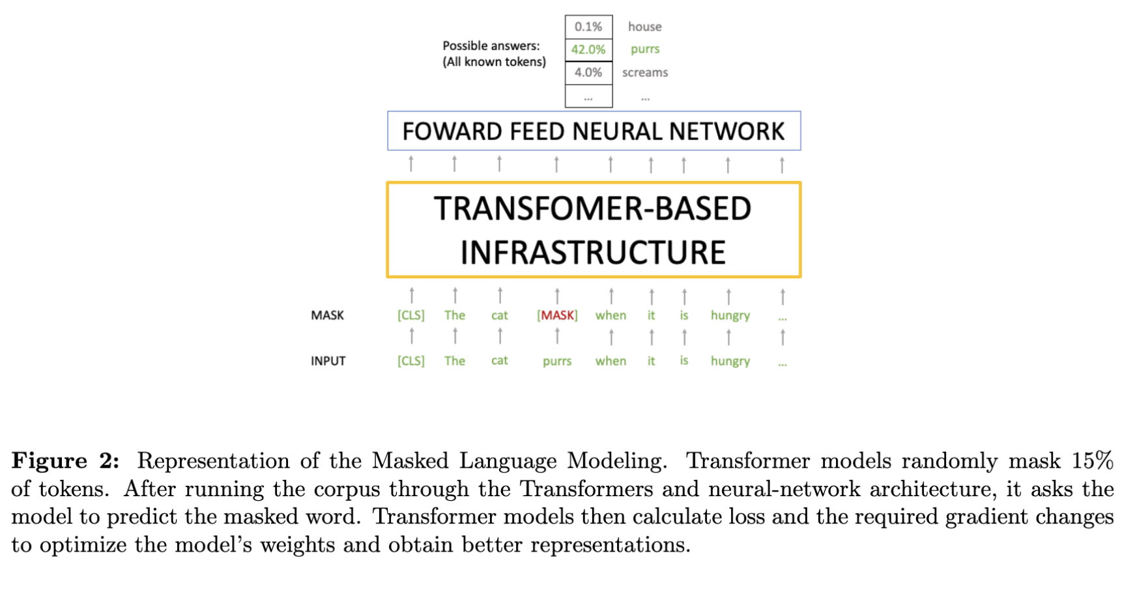

Slide 17
That is pretty cool. But how does BERT (and the BERT family) take advantage of the Transformers architecture?

Slide 18


BERT
PRE-TRAINED
MODEL
TEXT
TRANSFORMERS
A lot of this!

Slide 19
So, if we pass through Transformers, say, all of Wikipedia, we will get some very accurate representations of each word.
What BERT (which stands for Bidirectional Encoder Representations from Transformers), RoBERTa (a more accurate BERT model), XLM-RoBERTa (a cross-lingual RoBERTa model), and others do is take this architecture, make improvements*, and obtain pre-trained models that can accurately understand text.
*For example, BERT models take context into account, such that the embedding for bear in “teddy bear” will be different from the embedding for bear in “bear the loss.”

Slide 20
So, if we pass through Transformers, say, all of Wikipedia, we will get some very accurate representations of each word.
What BERT (which stands for Bidirectional Encoder Representations from Transformers), RoBERTa (a more accurate BERT model), XLM-RoBERTa (a cross-lingual RoBERTa model), and others do is take this architecture, make improvements*, and obtain pre-trained models that can accurately understand text.
*For example, BERT models take context into account, such that the embedding for bear in “teddy bear” will be different from the embedding for bear in “bear the loss.”

Slide 21
BERT and co. are trained across a number of layers. For example, BERT-base is trained across 12 layers and produce outputs word vectors of length 768, while the BERT-large model outputs word vectors of length 1,024 (the same applies to the base and large versions of RoBERTa and XLM-R).
Longer vectors contain a more accurate representation of a word, but also require more space and computational power.
Models using the Transformers architecture have also found ways to more accurately handle out-of-vocabulary tokens (e.g., byte-pair encoding).

Slide 22
Coolio… so how can we use them?

Slide 23
We can fine-tune the last layer of BERT and co. models and use them to predict labels from training set:

Slide 24


Prediction:
Predict
Sentence | Predict (Sentiment)
This is a cool project
You are a smart lad
Man, this is boring
I really like sociology
Labelled dataset
RoBERTa
Sentence | Label (Sentiment)
I love the red cat | Positive
I hate mice | Negative
That is a pleasant smell | Positive
That is not a pleasant smell | Negative
Trained model

Slide 25
But this is not it!
Additionally, BERT and company are open-source!!, which means that they are high customizable.
What if I have a corpus with specialized language that is unlikely to appear in the same context in the data used to pre-train BERT and co.? No problem, you can use a corpus with similar language to improve the representation of the words in the context of your corpus.
What if I have tokens that are highly informative but that are not in the the data used to pre-train BERT and co.? You can add those as well.
Can I change the masking strategy? Can I see what is going on in each encoding layer? Can I use the embeddings produced by BERT and co. and apply some dimension reduction algorithm? Can I create my own ChatBot? Can I train in one language and predict in another? Yes, yes, yes, year, and yes beibi

Slide 26
Huggingface

Slide 27
So, people all over the world, across different disciplines, have already customized and trained Transformers-based models for different tasks. Many of these are in a repository called Hugging Face.
When going over the code for this week, we will explore Hugging Face. However, you will be able to find there everything from Named entity recognition (NER) models to emotion prediction models to GPT models to model trained to predict hate speech to models trained to accommodate specific languages or specialized language (e.g., finance, Spanish, legal, Twitter) to models to summarize text to…

